Slide 1
Planning and Application Overview
Twitter Sentiment Analysis (TSA)
Team: David Pope, Nathan Craig, Mason Allaman, Manthan Kale

Slide 2
What is Twitter Sentiment Analysis?

Slide 3
Product Vision - Twitter Sentiment Analysis
Product Goals:
Determine the sentiment of Twitter posts for a specific item, phrase, product, etc.
Analyzes tweets and finds the emotion/sentiment behind it (positive, negative, happy, sad, calm, angry, etc.)
Provides the ability to analyze consumer opinions on products, current issues, or people

Slide 4
Why should you use TSA?
TSA Provides:
Quick feedback on a large scale
A fast analysis on current trends
Analyze reception to a product/campaign
Useful Tool For:
Marketers
Business/Political Analysts

Slide 5
VISION STATEMENT - TSA
For analysts and marketers who need to determine the general sentiment behind a product, campaign, or social phenomena, the TSA is a web application that provides a both simple and intuitive way to analyze tweets related to a given search term and determine a sentiment behind them. Unlike other Sentiment Analysis applications, our product has a clean interface and provides configurable search options for users.

Slide 6
Project Overview

Slide 7
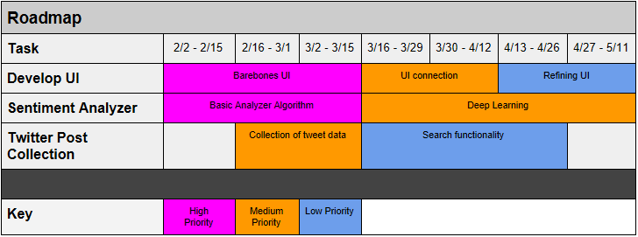
Product Roadmap

Slide 8
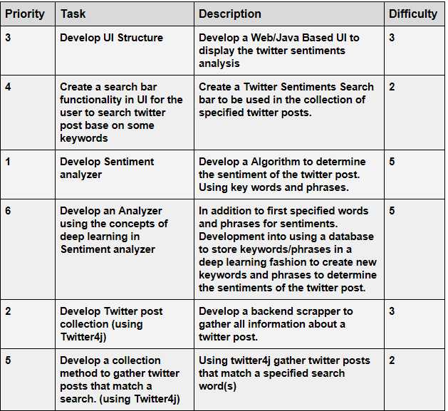
Product Backlog

Slide 9
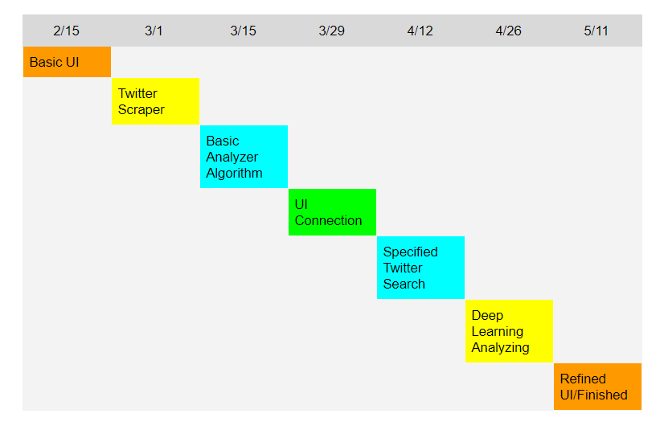
Release Timetable

